Slide 1

SECOND REVIEW Enhanced Diagnosis of Alzheimer's Disease through Predictive Progression Analysis of Neuro Imaging Sequences Project Category: RESEARCH
Guide Name Student Name & Registration Number
Dr. M. Karpagam V.R.Rishendra (RA2111026010221)
Rangineni Yukthamukhi (RA2111026010262)

Slide 2
Abstract
Alzheimer's disease (AD) is a progressive neurodegenerative disorder, often diagnosed too late for effective intervention with current techniques.​
This study proposes a deep learning framework combining Convolutional Neural Networks (CNNs) and Long Short-Term Memory (LSTM) networks for enhanced early AD diagnosis.​
CNNs extract spatial features from MRI neuroimaging data, identifying structural abnormalities linked to AD progression.​
LSTMs capture temporal patterns from sequential MRI scans, analyzing the progression of neurodegenerative changes over time.​
The hybrid CNN-LSTM model provides a comprehensive approach, improving diagnostic accuracy and enabling earlier detection of AD.​
This work aims to contribute to AI-driven AD diagnosis, leading to better prediction, personalized treatment, and improved patient outcomes.​

Slide 3
Introduction
Alzheimer's disease causes memory loss and cognitive decline, with early diagnosis crucial for slowing progression and improving quality of life.​
Current diagnostic methods often detect the disease only at moderate or advanced stages, limiting their effectiveness.​
AI, particularly deep learning models like CNNs, shows promise in improving the accuracy and timeliness of Alzheimer’s diagnosis.​
CNNs extract spatial features from MRI scans, while LSTMs capture temporal patterns of disease progression.​
The hybrid CNN-LSTM model combines spatial and temporal analysis to improve the accuracy of early diagnosis.​
This approach reduces false positives/negatives and can lead to AI-driven screening tools for better intervention and outcomes.​

Slide 4
Problem Statement
Alzheimer's Disease (AD) is a neurodegenerative disorder that causes cognitive decline and memory loss, impacting millions worldwide. Early detection is crucial for mitigating disease progression, but current diagnostic methods, including cognitive assessments and imaging analysis, can be time-consuming, expensive, and prone to variability. The increasing availability of brain imaging data, such as MRI scans, presents an opportunity to develop more efficient and accurate diagnostic tools using artificial
Utilizing deep learning algorithms, we aim to analyze brain MRI data to aid in the early detection and classification of different stages of Alzheimer's disease. Our project focuses on using convolutional neural networks (CNNs) and other deep learning techniques to automate and improve the diagnostic process. We will utilize a large, labeled dataset of brain images to develop and refine models that will surpass the accuracy and speed of traditional diagnostic methods.

Slide 5
Objectives
Developing a deep learning model for accurate Alzheimer's disease diagnosis.
To develop a hybrid deep learning model that combines Convolutional Neural Networks (CNNs) and Long Short-Term Memory (LSTM) networks for the early and accurate diagnosis of Alzheimer’s disease ​
leveraging MRI neuroimaging data to improve diagnostic accuracy, predict disease progression, and support personalized treatment planning, ultimately enhancing patient outcomes.​Improving prediction accuracy and enhancing model interpretability.
Validating model performance on external datasets.

Slide 6
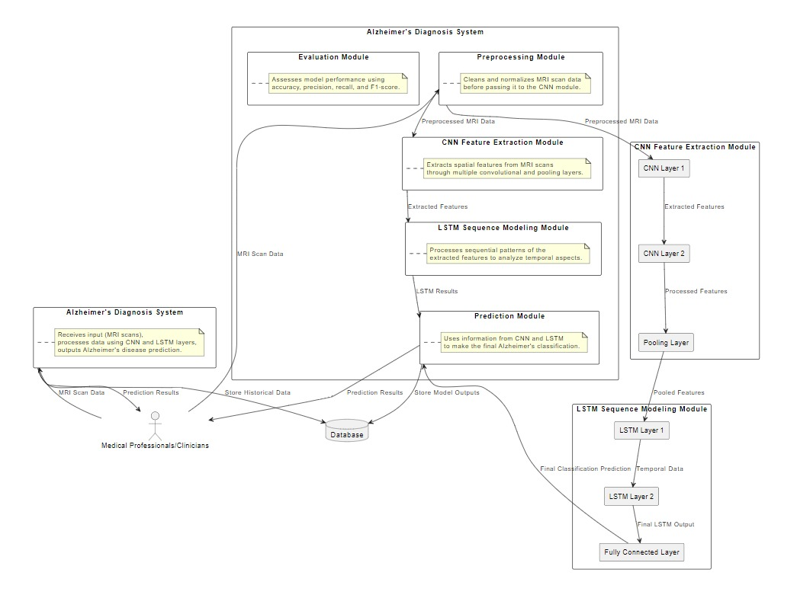
System Architecture

Slide 7
System Architecture
Level 0: Context DiagramExternal entities (Medical Professionals/Database) provide MRI scan data to the Alzheimer's Diagnosis System, which processes the data and returns prediction results for Alzheimer's disease classification.
Level 1: Alzheimer's Diagnosis SystemThe system includes Preprocessing, CNN Feature Extraction, LSTM Sequence Modeling, and Prediction modules that clean, analyze, and classify MRI data, outputting predictions to clinicians or a database.
Level 2: Detailed View of CNN and LSTM ModulesCNN layers extract spatial features, LSTM layers analyze temporal patterns, and a Fully Connected Layer provides the final Alzheimer's classification.

Slide 8
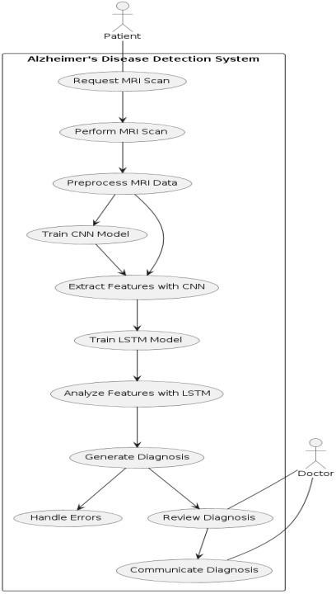
USECASE Diagram

Slide 9
USECASE Diagram
The UML diagram illustrates an Alzheimer's Disease Detection System, starting with a patient's MRI scan request and performance.
The system preprocesses the MRI data, trains a CNN model to extract features, and then utilizes an LSTM model for feature analysis.
The system generates a diagnosis based on these analyses.
The diagnosis is then reviewed by a doctor, communicated to the patient, and any errors are handled.

Slide 10
Datasets
Huggingface.co
https://huggingface.co/datasets/Falah/Alzheimer_MRI
It discusses the different classes of Alzheimer’s disease and provides information on how to download and use the dataset. ​
This dataset focuses on the classification of Alzheimer's disease based on MRI scans. The dataset consists of brain MRI images labeled into four categories:​
'0': Mild_Demented​
'1': Moderate_Demented​
'2': Non_Demented​
'3': Very_Mild_Demented​

Slide 11
Literature Survey
https://docs.google.com/spreadsheets/d/1h88fofBdt7ulPmumsoEF6eZ4gotj3XamKbaNAe_3dFY/edit?gid=0#gid=0
The integration of Convolutional Neural Networks (CNNs) and Long Short-Term Memory (LSTM) networks proves effective in analyzing brain imaging data. CNNs capture structural features in the data, while LSTMs provide temporal sequence analysis, refining diagnostic tools and improving accuracy. Additionally, Generative Adversarial Networks (GANs) generate synthetic data to better train machine-based algorithms and enhance predictive usefulness in longitudinal studies of individuals with Dementia or Alzheimer's Disease. This combined approach can contribute to more precise and accurate diagnoses of dementia and its neurodegenerative forms. I am particularly interested in exploring how the complementary nature of CNN and LSTM can provide more informative accounts of the changes to cognition resulting from Alzheimer's disease.

Slide 12

Features
Input Image Data: The CNN portion of the model extracts spatial features from the image data. The input image is typically a grayscale or multi-channel image, processed through a series of convolutional layers to extract meaningful spatial features like edges, textures, and patterns.
Flattening Feature Maps for LSTM Input:After feature extraction via CNN, the feature maps are flattened to match the expected input format of the LSTM.

Slide 13
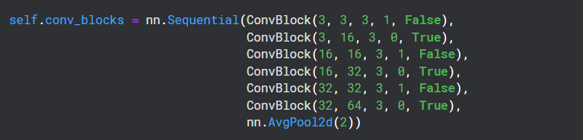
Features
Intermediate Feature Maps: These are generated by the convolutional layers (Block class) which extract increasingly complex patterns from the input images. These feature maps are then passed on to the LSTM for temporal analysis.

Slide 14
Classes
Classes refer to the output labels or categories that the model is trying to predict. In the context of Alzheimer's disease prediction, these classes could represent different stages of the disease, such as:
0: Normal (No Alzheimer's)
1: Mild Cognitive Impairment (MCI)
2: Early-stage Alzheimer's Disease
3: Late-stage Alzheimer's Disease
In our CNN-LSTM code, the classes are represented by the OUT_SIZE parameter, which defines the number of possible output classes the model predicts:
If OUT_SIZE=4,the model will classify the input data into 4 classes: normal, MCI, early-stage, and late-stage Alzheimer's disease.

Slide 15
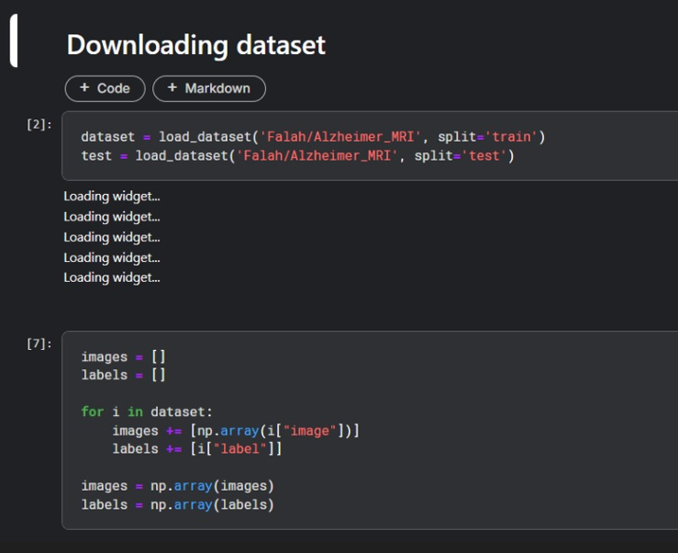
Implementation Screenshots

Slide 16
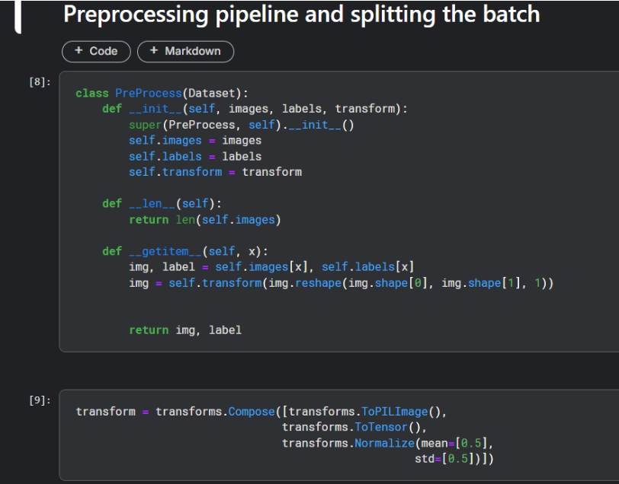

Slide 17
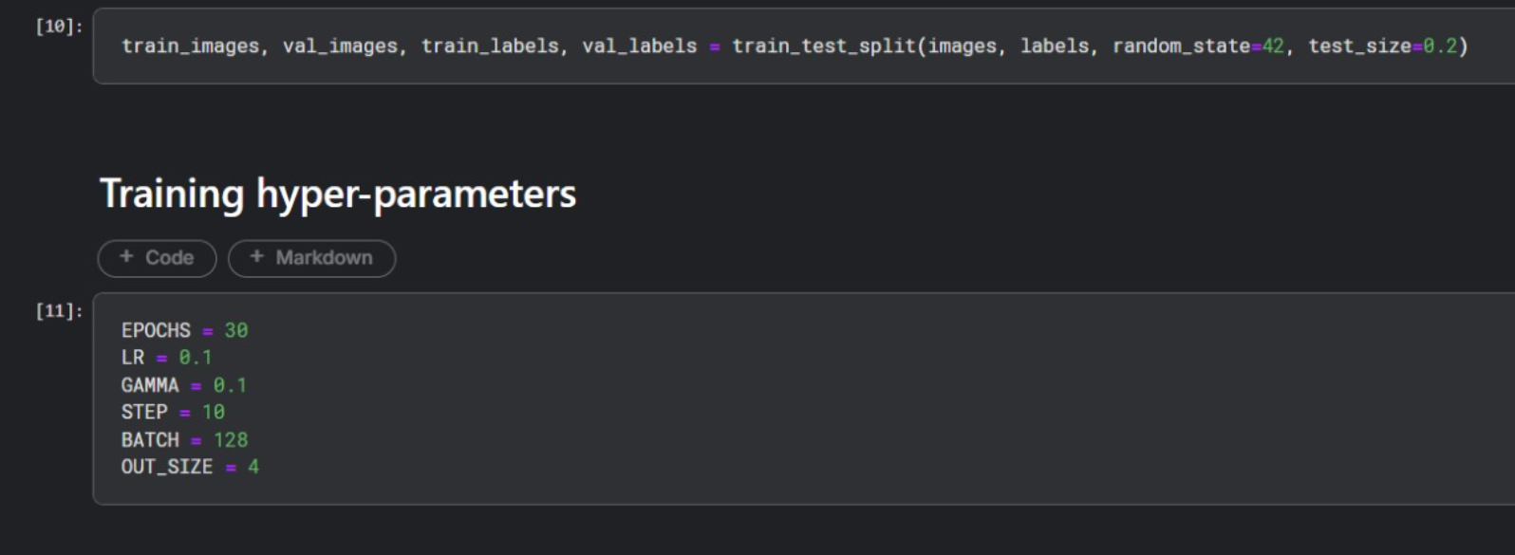

Slide 18
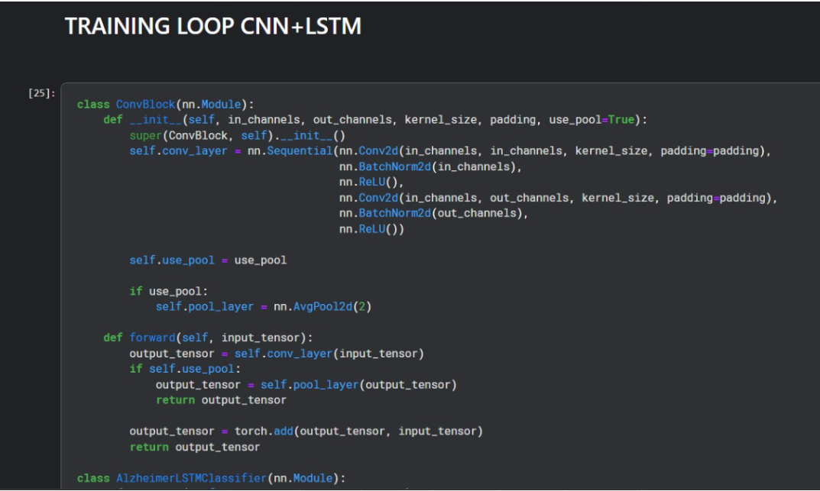

Slide 19
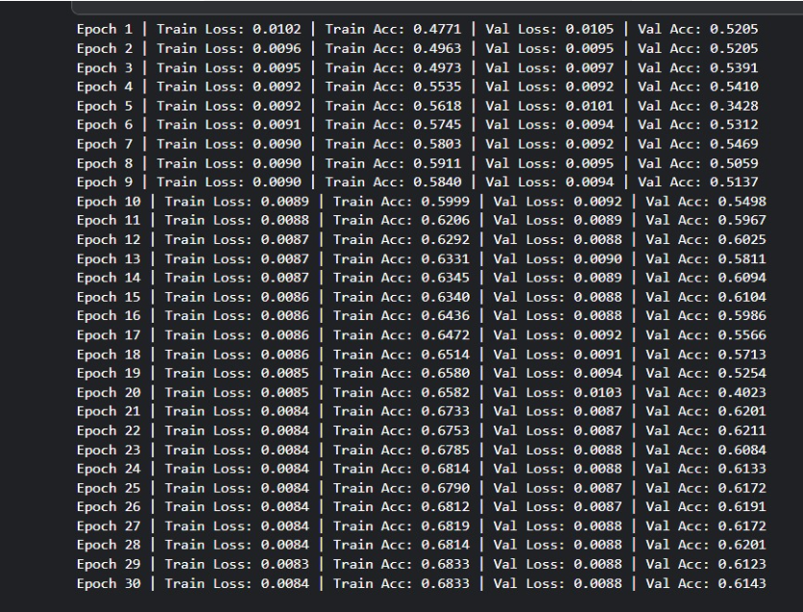

Slide 20
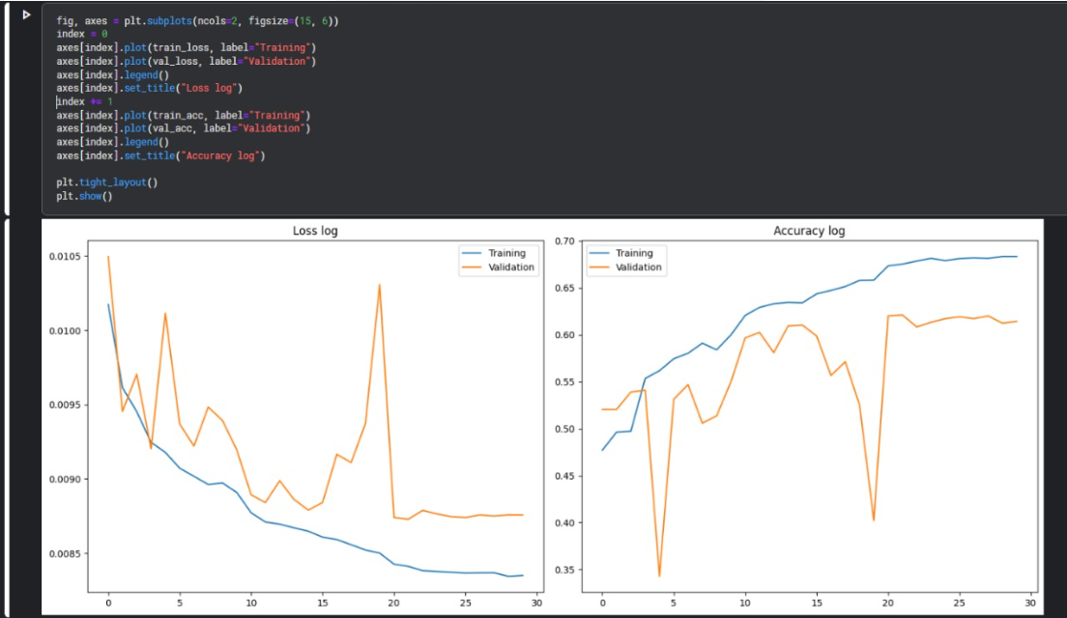

Slide 21
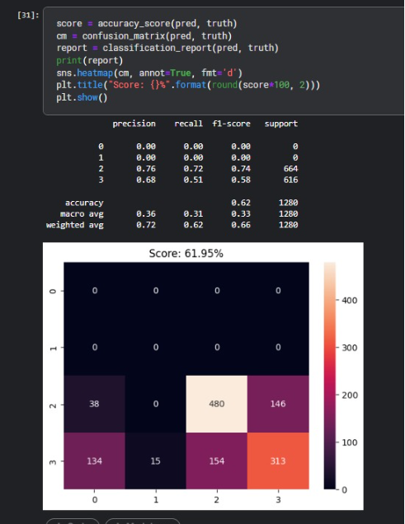

Slide 22
Limitations
Models may not consistently perform well across different populations and with various imaging technologies.
Deep learning models may lack transparency, making it difficult for clinicians to adopt them for clinical use.
Incomplete or inconsistent follow-up data can affect the analysis of disease progression.
Training and running complex models require significant computational resources.
Models may perform well on training data but struggle with new, unseen cases.
There are privacy and data security risks associated with handling sensitive medical data.
The real-world use of deep learning models may face a lengthy regulatory approval and integration process.

Slide 23
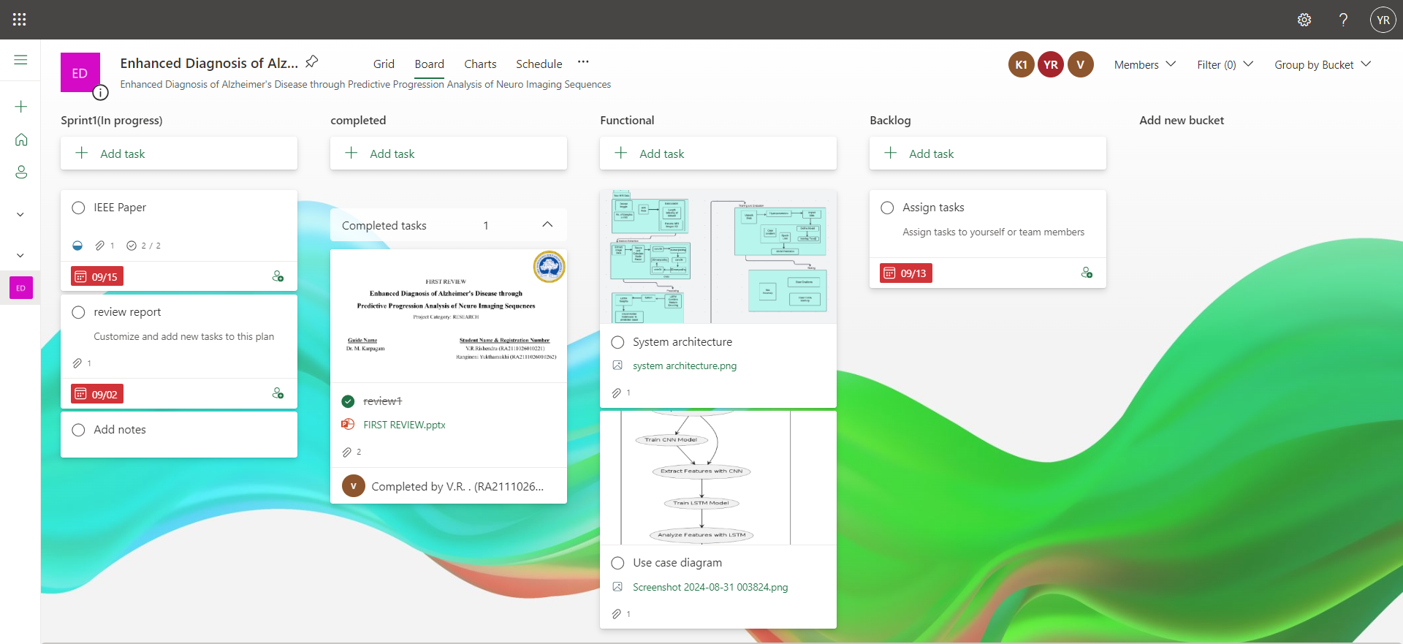
MS Planner Screenshots

Slide 24
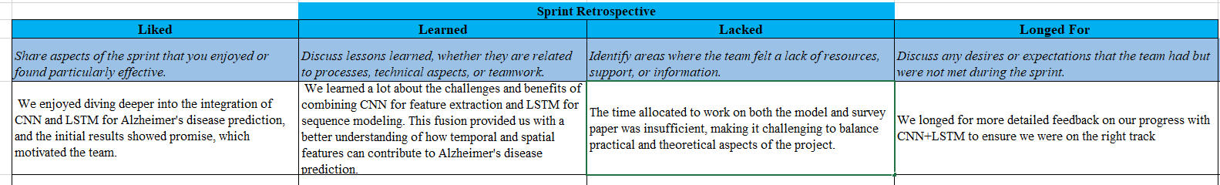
Sprint Report

Slide 25
References
https://ieeexplore.ieee.org/abstract/document/9521165?casa_token=8lyvdGTqEPUAAAAA:hvcmIjM_dEdgaLn1C_hcHWkhfbPwS783k29-Cqf7dts7UWJF-b5ngikgbthXfg4ZvWFIT-PsNA
https://onlinelibrary.wiley.com/doi/full/10.1155/2008/403896
https://ieeexplore.ieee.org/abstract/document/8737996
https://ieeexplore.ieee.org/abstract/document/8888197?casa_token=bwNZCA6RAUgAAAAA:UghnjruUU_7acMDSIEXLGnt5EZdMsvKbZKK5OYyFjziVuWUfgFhxOQLcSMIbgz3fEN_y7BMcog
https://www.ncbi.nlm.nih.gov/pmc/articles/PMC8249997/

